Slide 1

CHC Contracting Overview

Slide 2
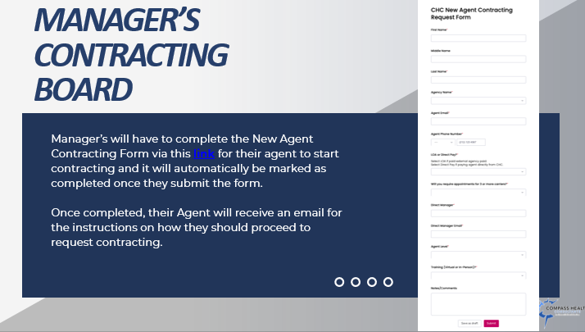
Manager Steps
If you have someone you want to bring aboard, you will complete the following link.
Contracting Request for Agents/Agencies
https://wkf.ms/4cErFQa
REMINDERS
You should not be sending any links.
You must complete the link as it requires the agent’s level and direct manager.
Questions should be directed to CHC Contracting, contracting@chcquotes.com.

Slide 3
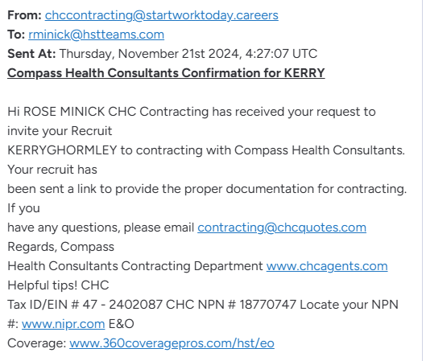
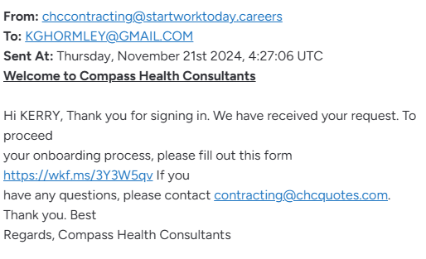
Submission Notifications
Manager Email Notification
If you have not participated in CHC Contracting
You will need to be invited to Monday.com. This will
Come as an email.
Agent Email Notification
Contains a link that Gets all the required information
we need to satisfy CHC Finance.
DO NOT SEND THIS LINK or ANY LINK.
If the agent didn’t receive or you would like it resent, email
CHC Contracting, contracting@chcquotes.com.

Slide 4
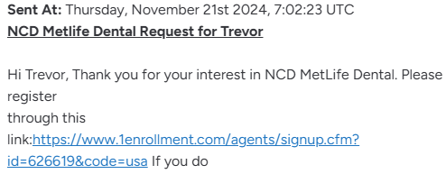
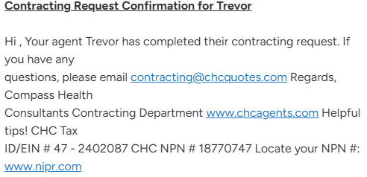
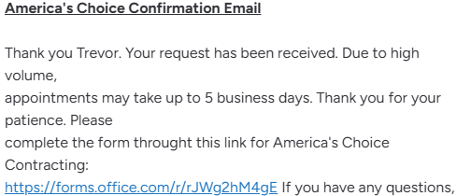
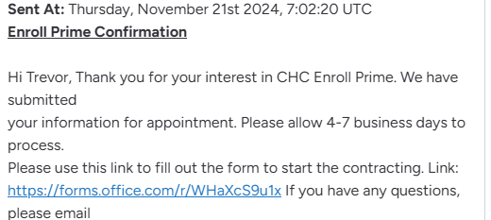
Carrier Contracting Agent Email Examples
Manager Email Notification
Once your agent satisfies the requirement
You will receive an email confirmation. The agent then receives their links to contract with your requested carriers.

Slide 5
Your agents can be found in 3 Boards in Monday.com
Agents listed in this board are recruits submitted by Hiring MGRs and CHC Recruiting.
Recruit completes onboarding link sent by Contracting and is approved.
Manager Contracting Request Board
External Contracting Agent Board
Internal Contracting Agent Board

Slide 6
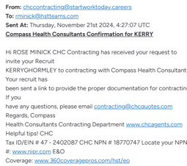
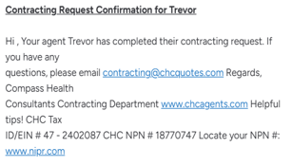
POV: Hiring Mgr.
Submit Recruit Info via Monday.com link.
Receive email confirmation of recruit onboarding link sent
Receive email confirmation of recruits onboarding documents
Contracting Request Form
https://wkf.ms/4cErFQa
EXAMPLE
EXAMPLE

Slide 7
How Agents Receive Carrier Contracting Links
Microsoft Form Links
Carrier Direct Links
Monday.com Form Links
Adobe Documents Instructions (ACA)
HST BrokerBox

Slide 8
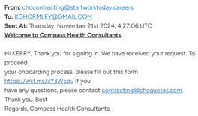
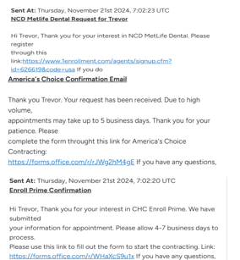
POV: Recruit
Email sent with onboarding link for recruit to complete
Recruit provides all documentation via onboarding link
Recruit documents reviewed for accuracy. Recruit may receive emails from CHC contracting for corrections. Notes provided for MGR.
Recruit approved and emailed carrier contracting links requested by MGR.
This is info submitted directly to the carriers
EXAMPLE
EXAMPLE

Slide 9

CHC CONTRACTING ADDITIONAL REQUEST LINK https://forms.monday.com/forms/9508297440e8ac95cfedbacaeebe7896?r=use1
Additional Carrier Contracts
Request CHC Email Access
Request TopBroker CRM Access
Request Agent Releases

Slide 10

CHC Finance Department Requests (payroll@chcquotes.com) https://forms.monday.com/forms/42c925f26891323fd9906379aa6870ce?r=use1
Name Change
Address Change
Payroll Change
Hierarchy/Level Change
Others

Slide 11
CHC Finance Update Board Flowchart
Update Hierarchy/Pay Level?
Update Name?
Update Address?
Update Direct Deposit Information?
STOP
Submit request through Monday.com using this link
https://forms.monday.com/forms/42c925f26891323fd9906379aa6870ce?r=use1
UPLINE MUST REQUEST IN MONDAY.COM AND FILL OUT HIERARCHY CHANGE FORM
You will need the following documents uploaded into Monday.com
Documents to support Name Change:
i.e. Marriage License,
Divorce Decree, Court Order
No documents required for address change
-Updated W-9 that matches bank information
-Voided Check/ Bank letter that matches W-9

Slide 12


CHC Contracting Staff
Tanya Mosley & Mimi Crisostomo,
Email Contacts
contracting@chcquotes.com
contracting@startworktoday.careers
tmosley@chcquotes.com
www.chcagents.com
https://www.chcagents.com/department-faqs

